Slide 1


Slide 2
Problem Solution Essays
The Question
The 3 essay types:
Problem and solution
Cause and solution
Just the solution

Slide 3
Problem Solution Essays
One problem faced by almost every large city is traffic congestion.
What do you think the causes are? What solutions can you suggest?
Give reasons for your answer and include any relevant examples from your own knowledge or experience.
Write at least 250 words.

Slide 4
Answer
One of the most serious issues facing the majority of large urban areas is traffic jam. The main reason for this is that there are too many private cars on the roads these days and a viable solution is to introduce more park-and-ride schemes.
The number of people owning cars increases year on year, with most families now having more than one car. Most people like the convenience of travelling at the time they want to rather than being restricted to public transport timetables, so they prefer to drive themselves around rather than taking the bus or train. This is despite the fact that they frequently have to sit in long traffic queues as they near the city center. Whenever I have to attend a meeting in the city, I always drive because it means that I can leave home when I want to rather than getting stressed about getting to the station in time to catch the train.
A solution that is proving successful in many areas is park-and-ride schemes. This is where one parks their car for free in a large car park on the outskirts of the city and takes a bus for the final part of their journey. The fee they have to pay for the bus trip is usually very small and this public transport system is generally very regular, running every ten minutes or so. A survey carried out in a well known city showed that the rush hour congestion decreased by 10% when the council set up a park-and-ride scheme to the north of the city. There was an additional drop of another 10% in traffic volume when a second scheme began operating to the south.
To conclude, the major urban problem of traffic congestion caused by the excessive number of private cars on city roads can be partly alleviated by the introduction of park-and-ride systems on city fringes. I would certainly use one if it was introduced in my area.
(328 words)

Slide 5
BREAKDOWN AND EXPLANATION

Slide 6
Problem Solution Essays
It’s important that you are able to recognise the common synonyms, words and phrases used in problem solution questions. Here are the key words and their synonyms used in the questions above.
Problem – issues, resulting, situation
Cause – reasons, why
Solution – deal with, addressed, tackled, remedied, improved, measures taken, solved, prevent

Slide 7
Problem Solution Essays
6 Common Mistakes
These six errors are common in IELTS problem solution essays.
Confusing problem and causes questions.
Having too many ideas.
Not developing your ideas.
Not developing both sides of the argument equally.
Not linking the problems and solutions.
Not being specific enough.

Slide 8
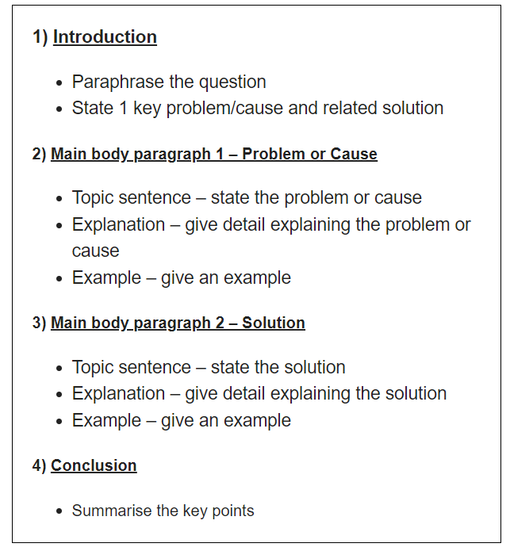
Problem
Solution
Essays
Essay Structure

Slide 9
Introduction
A good introduction has a simple 3 part structure:
1) Paraphrased question
2)State 1 key problem/cause and related solution/s (outline sentence)
An introduction should:
Have 2-3 sentences
Be 40-60 words long
Take 5 minutes to write

Slide 10
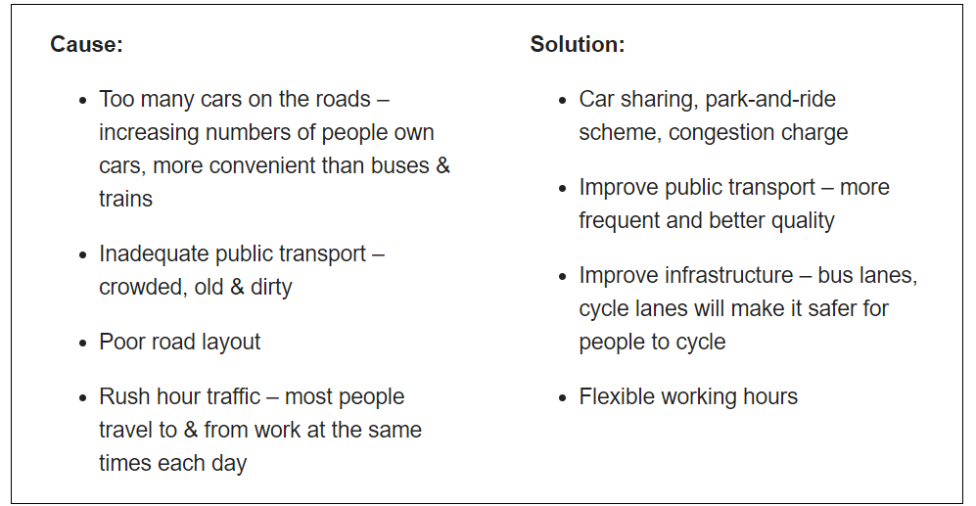
Ideas
Question: One problem faced by almost every large city is traffic congestion.
What do you think the causes are? What solutions can you suggest?

Slide 11
Introduction
Question: One problem faced by almost every large city is traffic congestion.
What do you think the causes are? What solutions can you suggest?
Paraphrased question:
One of the most serious issues facing the majority of large urban areas is traffic jam.
Outline statement:
The main reason for this is that there are too many private cars on the roads these days and a viable solution is to introduce more park-and-ride schemes.
Cause – Too many cars on the roads. Why? – increasing numbers of people own cars, more convenient than buses & trains
Solution – Park-and-ride schemes
DO NOT GIVE ANY HEADING
THE HEADINGS OF THE PARAGRAPHS ARE FOR EXPLANATION ONLY
YOUR WRITING SHOULD ONLY HAVE PARAGRAPHS AS SHOWN IN THE LAST SLIDE

Slide 12
Question: One problem faced by almost every large city is traffic congestion.
What do you think the causes are? What solutions can you suggest?
Introduction:
One of the most serious issues facing the majority of large urban areas is traffic jam. The main reason for this is that there are too many private cars on the roads these days and a viable solution is to introduce more park-and-ride schemes.
*schemes-a large-scale systematic plan or arrangement for attaining a particular object
DO NOT GIVE ANY HEADING
THE HEADINGS OF THE PARAGRAPHS ARE FOR EXPLANATION ONLY
YOUR WRITING SHOULD ONLY HAVE PARAGRAPHS AS SHOWN IN THE LAST SLIDE

Slide 13
How To Write Main Body Paragraphs
Topic sentence
Explanation
Example

Slide 14
Main Body Paragraph 1: Too many cars on the roads
Topic sentence:
The number of people owning cars increases year on year, with most families now having more than one car.
Explanation sentence:
Most people like the convenience of travelling at the time they want to rather than being restricted to public transport timetables, so they prefer to drive themselves around rather than taking the bus or train. This is despite the fact that they frequently have to sit in long traffic queues as they near the city centre.
Example sentence:
Whenever I have to attend a meeting in the city, I always drive because it means that I can leave home when I want to rather than getting stressed about getting to the station in time to catch the train.
DO NOT GIVE ANY HEADING
THE HEADINGS OF THE PARAGRAPHS ARE FOR EXPLANATION ONLY
YOUR WRITING SHOULD ONLY HAVE PARAGRAPHS AS SHOWN IN THE LAST SLIDE

Slide 15
Finished Paragraph 1
The number of people owning cars increases year on year, with most families now having more than one car. Most people like the convenience of travelling at the time they want to rather than being restricted to public transport timetables, so they prefer to drive themselves around rather than taking the bus or train. This is despite the fact that they frequently have to sit in long traffic queues as they near the city centre. Whenever I have to attend a meeting in the city, I always drive because it means that I can leave home when I want to rather than getting stressed about getting to the station in time to catch the train.
DO NOT GIVE ANY HEADING
THE HEADINGS OF THE PARAGRAPHS ARE FOR EXPLANATION ONLY
YOUR WRITING SHOULD ONLY HAVE PARAGRAPHS AS SHOWN IN THE LAST SLIDE

Slide 16
Main Body Paragraph 2: Park-and-ride schemes
Topic sentence:
A solution that is proving successful in many areas is park-and-ride schemes.
Explanation sentence:
This is where one parks their car for free in a large car park on the outskirts of the city and takes a bus for the final part of their journey. The fee they have to pay for the bus trip is usually very small and this public transport system is generally very regular, running every ten minutes or so.
Example sentence:
A survey carried out in a well known city showed that the rush hour congestion decreased by 10% when the council set up a park-and-ride scheme to the north of the city. There was an additional drop of another 10% in traffic volume when a second scheme began operating to the south.
DO NOT GIVE ANY HEADING
THE HEADINGS OF THE PARAGRAPHS ARE FOR EXPLANATION ONLY
YOUR WRITING SHOULD ONLY HAVE PARAGRAPHS AS SHOWN IN THE LAST SLIDE
*outskirts-the outer parts of a town or city

Slide 17
Finished Paragraph 2
A solution that is proving successful in many areas is park-and-ride schemes. This is where one parks their car for free in a large car park on the outskirts of the city and takes a bus for the final part of their journey. The fee they have to pay for the bus trip is usually very small and this public transport system is generally very regular, running every ten minutes or so. A survey carried out in a well known city showed that the rush hour congestion decreased by 10% when the council set up a park-and-ride scheme to the north of the city. There was an additional drop of another 10% in traffic volume when a second scheme began operating to the south.
DO NOT GIVE ANY HEADING
THE HEADINGS OF THE PARAGRAPHS ARE FOR EXPLANATION ONLY
YOUR WRITING SHOULD ONLY HAVE PARAGRAPHS AS SHOWN IN THE LAST SLIDE

Slide 18
Conclusion
You can start almost any final paragraph of an IELTS essay with the words:
In conclusion
or
To conclude
To create a great conclusion, you simply have to paraphrase the introduction

Slide 19
Question: One problem faced by almost every large city is traffic congestion.
What do you think the causes are? What solutions can you suggest?
Introduction:
One of the most serious issues facing the majority of large urban areas is traffic jams. The main reason for this is that there are too many private cars on the roads these days and a viable solution is to introduce more park-and-ride schemes.
Conclusion
To conclude, the major urban problem of traffic congestion caused by the excessive number of private cars on city roads can be partly alleviated by the introduction of park-and-ride systems on city fringes. I would certainly use one if it was introduced in my area.
*alleviate-reduce
*fringes-border of an area
DO NOT GIVE ANY HEADING
THE HEADINGS OF THE PARAGRAPHS ARE FOR EXPLANATION ONLY
YOUR WRITING SHOULD ONLY HAVE PARAGRAPHS AS SHOWN IN THE LAST SLIDE

Slide 20
Answer
One of the most serious issues facing the majority of large urban areas is traffic jam. The main reason for this is that there are too many private cars on the roads these days and a viable solution is to introduce more park-and-ride schemes.
The number of people owning cars increases year on year, with most families now having more than one car. Most people like the convenience of travelling at the time they want to rather than being restricted to public transport timetables, so they prefer to drive themselves around rather than taking the bus or train. This is despite the fact that they frequently have to sit in long traffic queues as they near the city center. Whenever I have to attend a meeting in the city, I always drive because it means that I can leave home when I want to rather than getting stressed about getting to the station in time to catch the train.
A solution that is proving successful in many areas is park-and-ride schemes. This is where one parks their car for free in a large car park on the outskirts of the city and takes a bus for the final part of their journey. The fee they have to pay for the bus trip is usually very small and this public transport system is generally very regular, running every ten minutes or so. A survey carried out in a well known city showed that the rush hour congestion decreased by 10% when the council set up a park-and-ride scheme to the north of the city. There was an additional drop of another 10% in traffic volume when a second scheme began operating to the south.
To conclude, the major urban problem of traffic congestion caused by the excessive number of private cars on city roads can be partly alleviated by the introduction of park-and-ride systems on city fringes. I would certainly use one if it was introduced in my area.
(328 words)

